Slide 1
Digital Portfolio
STUDENT NAME: M.GOWRI
REGISTER NO AND NMID: 2422K0012,asbruap2422k0012
DEPARTMENT: COMPUTER SCIENCE
COLLEGE:PPG COLLEGE OF ARTS AND SCIENCE/BHARATIAR UNIVERSITY

Slide 2
PROJECT TITLE SIMPLE PORTFOLIO

Slide 3


AGENDA
Problem Statement
Project Overview
End Users
Tools and Technologies
Portfolio design and Layout
Features and Functionality
Results and Screenshots
Conclusion
Github Link
3/21/2024 Annual Review

Slide 4

PROBLEM STATEMENT
Many students and professionals struggle to create an effective online portfolio that clearly showcases their skills, projects, and contact information in a professional and visually appealing way. Often, existing portfolios are either too complex to build or lack proper structure, making it difficult for potential employers or clients to assess the individual's capabilities.

Slide 5

PROJECT OVERVIEW
The project aims to develop a simple, responsive, and clean portfolio website for Gowri, a BSc Computer Science student. This portfolio will highlight personal information, skills, and various projects completed during studies or personal work. The portfolio will be easy to navigate and will include a contact form for direct communication.

Slide 6

WHO ARE THE END USERS?
Potential employers looking for developers or technical interns.
Academic mentors and professors who want to review project progress.
Clients interested in hiring for freelance or contract work.
Peers and collaborators for networking and knowledge sharing.

Slide 7

TOOLS AND TECHNIQUES
HTML5: For structuring the content of the portfolio.
CSS3: For styling the website and making it responsive.
JavaScript: To add interactivity, such as a mobile menu toggle and contact form handling.
Code Editor: Visual Studio Code, Sublime Text, or any editor.
Browser: Chrome, Firefox, or others for testing.

Slide 8
POTFOLIO DESIGN AND LAYOUT
A header with the name and navigation links to sections.
About Me section with a short bio.
Projects section listing individual project cards with titles and descriptions.
Contact section with a form for visitors to send messages.
The layout is responsive to work on both desktop and mobile devices.
A clean and minimalistic design with soft colors and easy-to-read fonts.
8

Slide 9
FEATURES AND FUNCTIONALITY
Project cards that display key project information.
Contact form with basic validation and a thank-you alert on submission.
Responsive navigation menu with toggle button on smaller screens.
Smooth hover effects and transitions for better user experience.
Sticky header so navigation is accessible when scrolling.

Slide 10
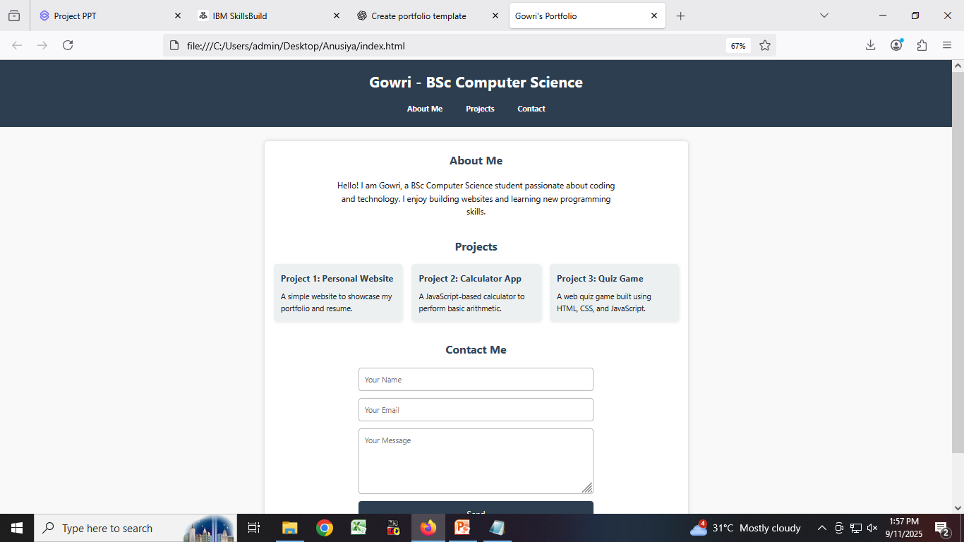

RESULTS AND SCREENSHOTS
3/21/2024 Annual Review
10

Slide 11
CONCLUSION
The portfolio successfully demonstrates core web development skills including HTML structure, CSS styling, and JavaScript interactivity. It serves as a practical showcase of projects and personal information, optimized for usability and accessibility. Future enhancements may include backend integration for contact form submissions, animations, and additional project filtering.
11

